Slide 1


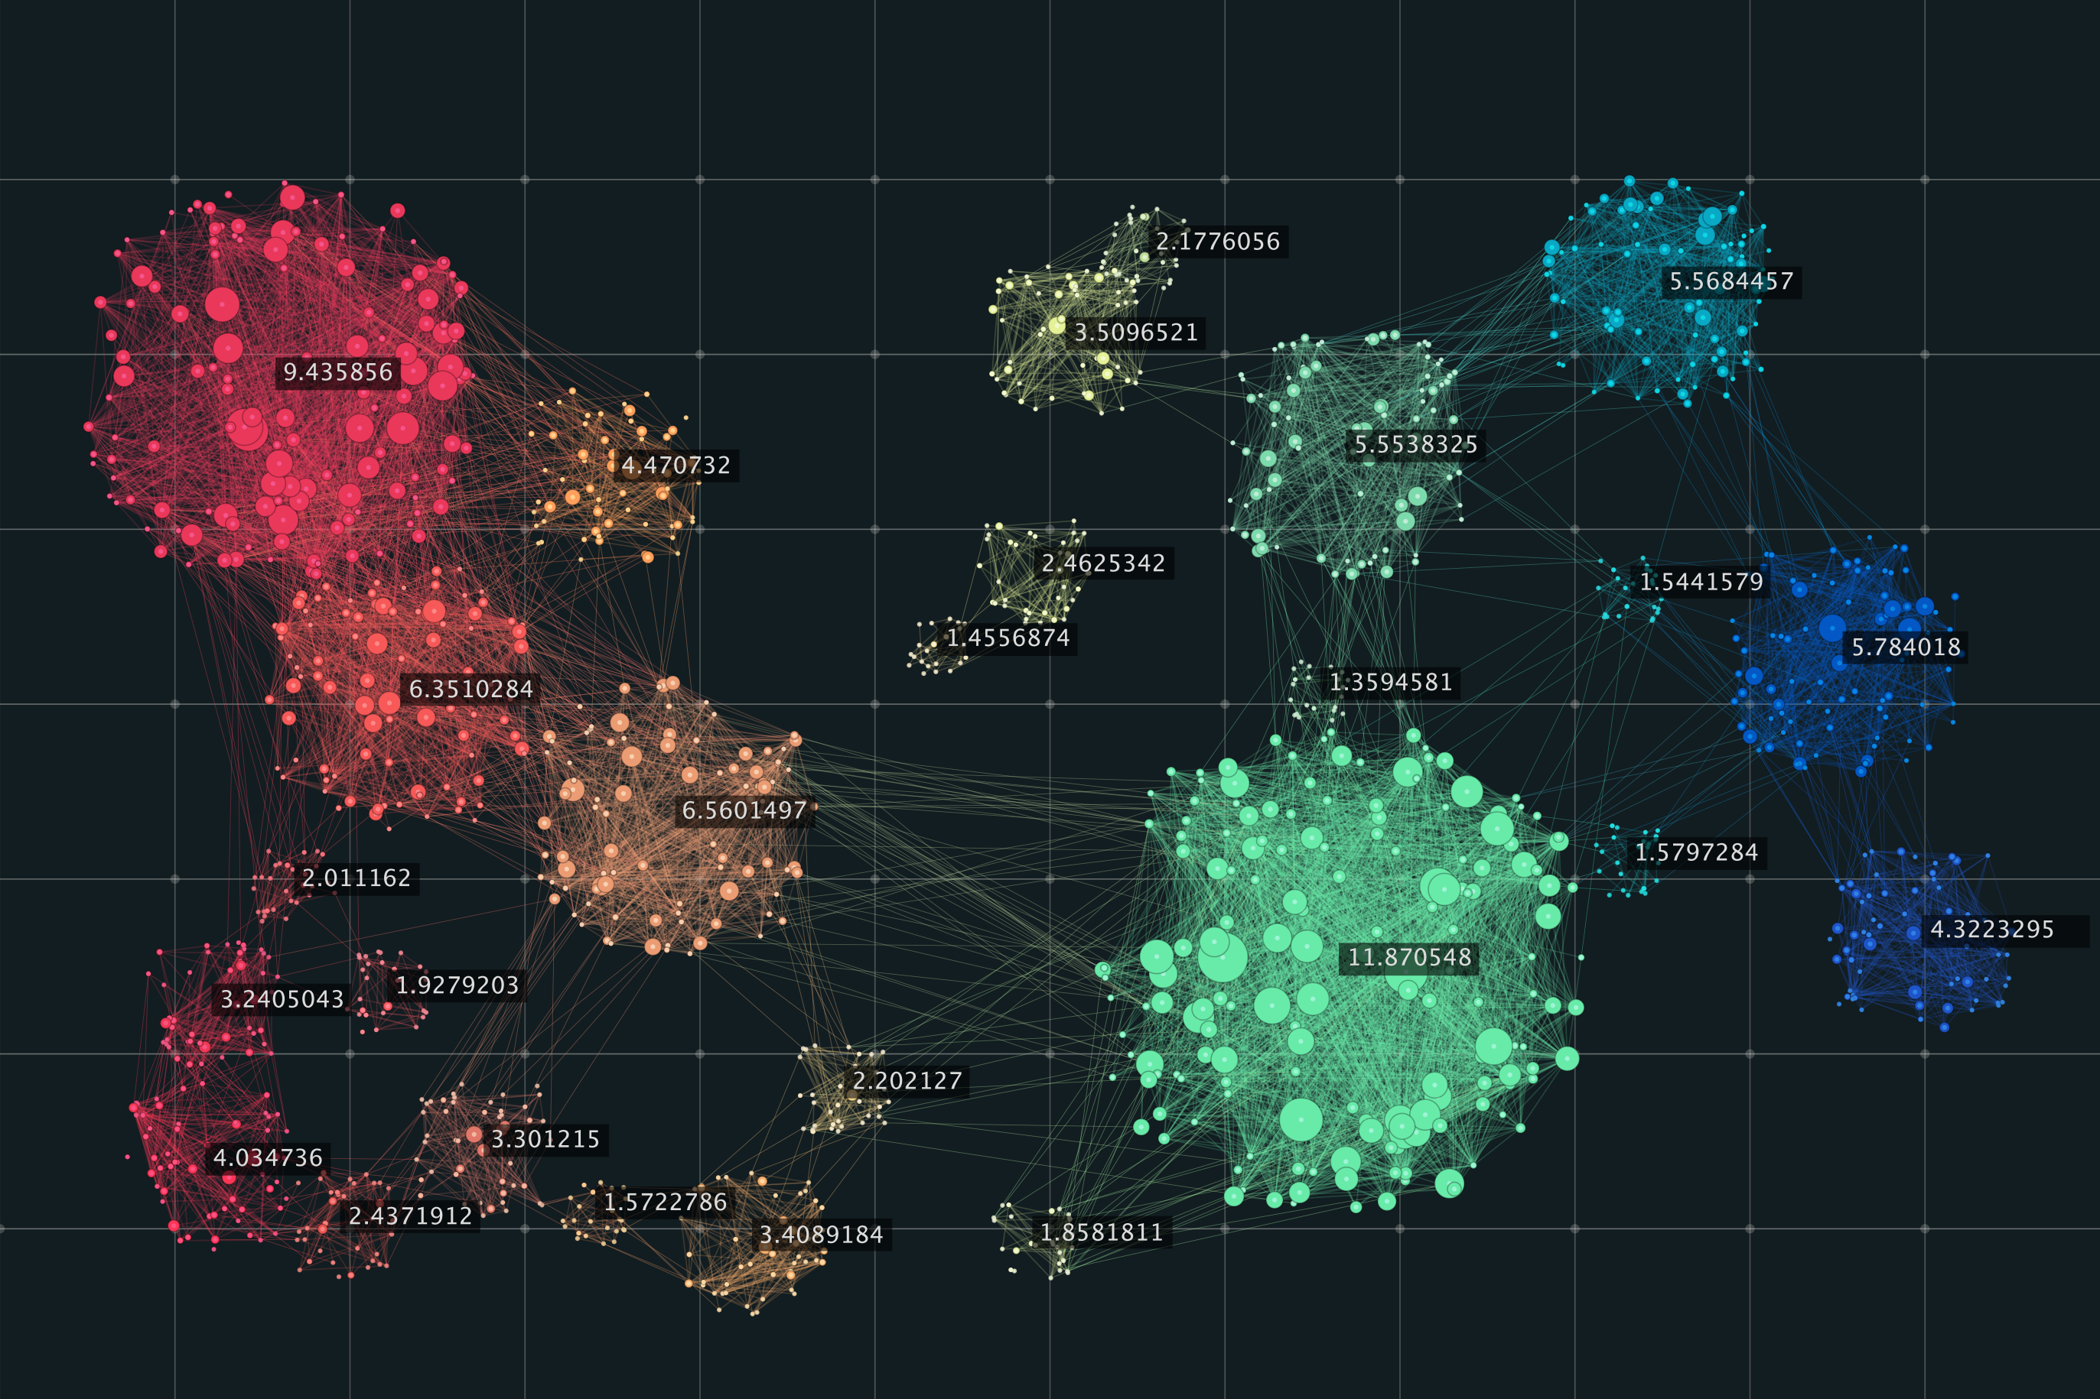




Geographical features
Data Child₁
New feature₁
Physical features
Data Child₂
New feature₂
Original Data
Economical features
Split Criteria
K-means Cluster
Data Child_{i}
New feature_{i}
Subsets of Original Data
New features

Slide 2










XGBoost Regression
Prediction Residuals
Prediction Residuals
New Data
New Data
New Data
Fitting
Fitting
Fitting
Selected
Decision Tree₁
Decision Tree₂
Decision Tree_{t}
New features
Price
New Data
Price Predictor
Selected
Original features
Y
X
Multiple Linear Regression

Slide 3






Can it fly?
If is flying?
Can it swim?

Slide 4

Year
Draft
Variant
Length
Sailboat Specifications
Make
Beam
Displacement

Slide 5

Country
Inflation Rate
GDP
Region
Position Traits
Unemployment Rate

Slide 6
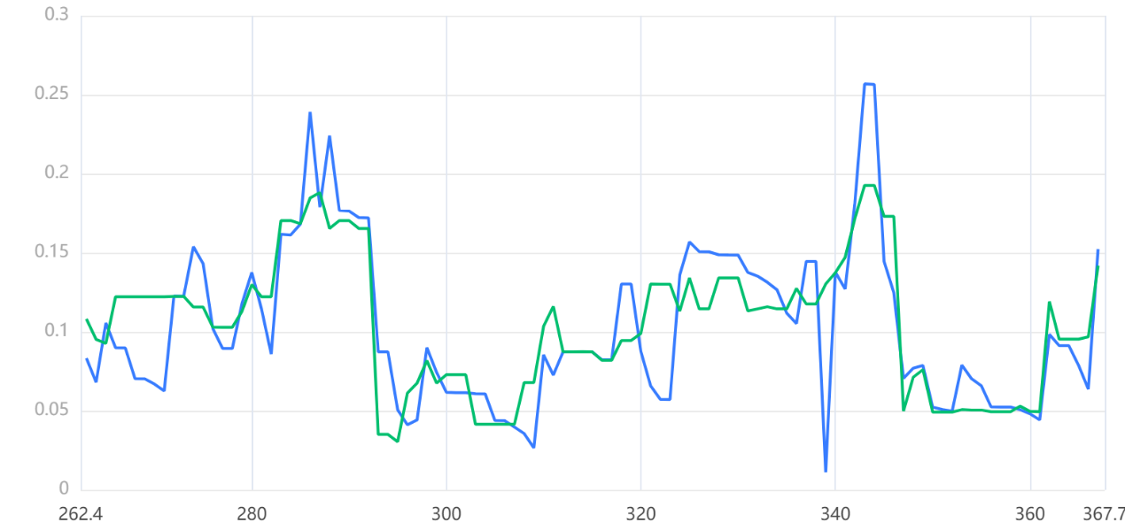
Real
Prediction

Slide 7



GDP
CPI
HDI
Economical Data
Sell variant X in place Y ?
Climate
Temperature
Geographical Data
Sailing Area
Price Predictor
Price
Price Calibration
LWL
Sailboat Data
Displacement
Dataset
Length

